Slide 1
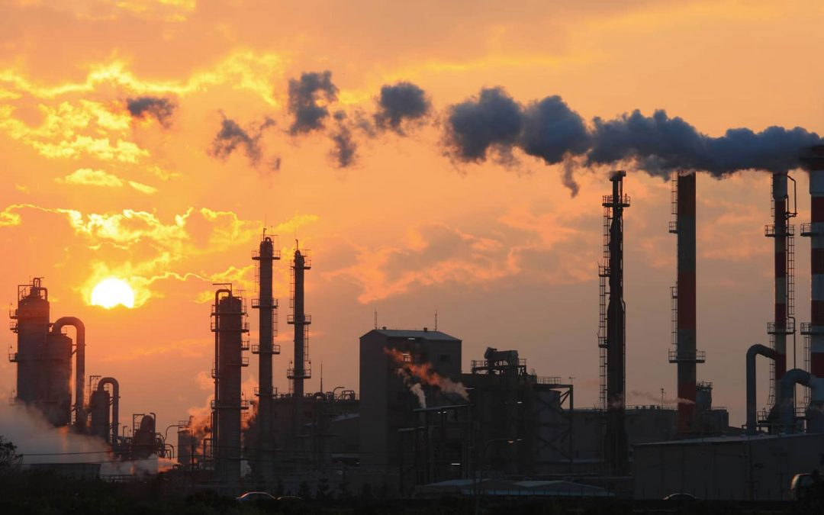
India Air Quality Index
Forecasting
Team Forecaster: Katy Shih, Kitae Kim, Kshitiz Sahay, Welly Huang
GitHub: https://github.com/k-kshitiz/india-air-quality-index-forecast/tree/main
Notes:
Kshitiz: Edited this slide (change if needed)

Slide 2
Agenda
Business Problem
EDA
Analysis and Modeling
Model Performance Results
Future Work
Notes:
Kshitiz: Edited this slide (change if needed)

Slide 3
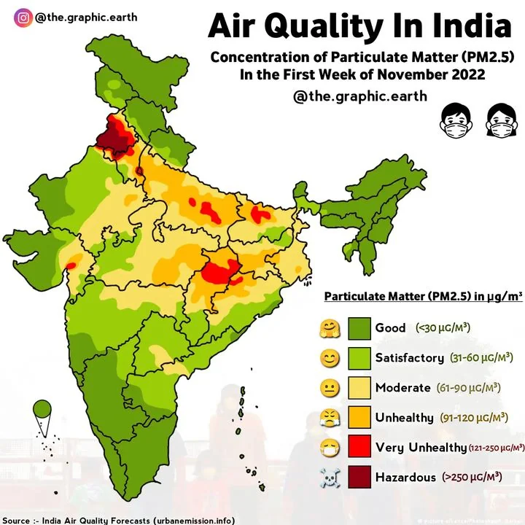
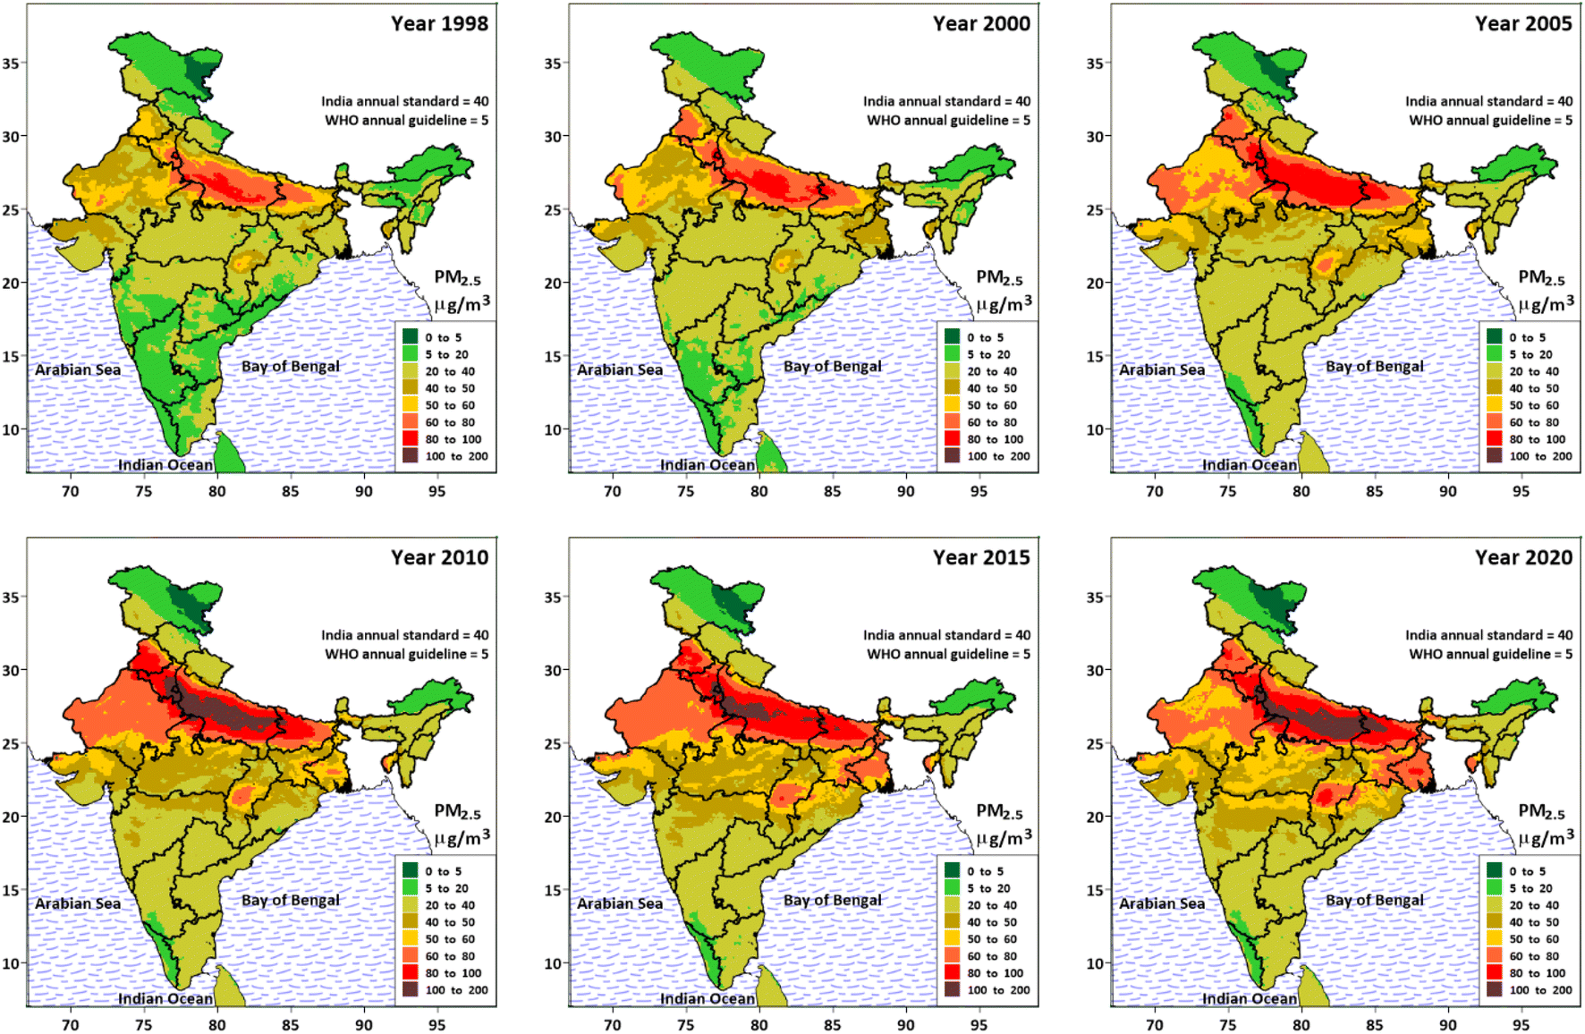
Air quality in major Indian cities is hazardous Business Problem
Rising Air Pollution Levels
Potential Causes
Factory emissions
Vehicle emissions
Waste burning
Agricultural activities
Fossil fuel
Weak policies
Air quality in many Indian cities is deteriorating rapidly.
High levels of pollutants such as PM2.5, PM10, NO2, and SO2.
Notes:
Kshitiz: Edited this slide (change if needed)
Present: Katy

Slide 4
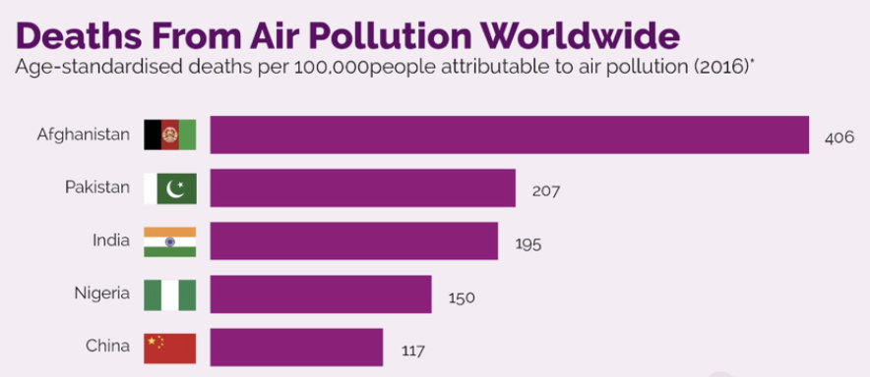
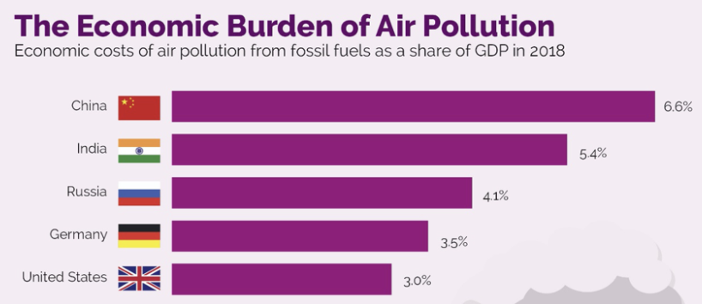
Forecasting AQI would improve public health and economy Objective
Objective
Forecast Air Quality Index (AQI) of major Indian cities to help mitigate the adverse effects of air pollution.
What are the future trends in air quality across India?
Can accurate forecasting help policy making and public health?
What seasonal variations affect air quality?
Key Questions We Want to Answer
Business Impact of AQI Forecast Model
Improved public health
Implementing better policies
Reduced economic costs
Raising awareness
Notes:
Kshitiz: Edited this slide (change if needed)
Present: Katy

Slide 5
Assumptions/Hypotheses
The historical data is accurate and consistent
The time series data is stationary
AQI patterns exhibit seasonal variations
Notes:
Kitae
Kshitiz: Added some content (change if needed)

Slide 6
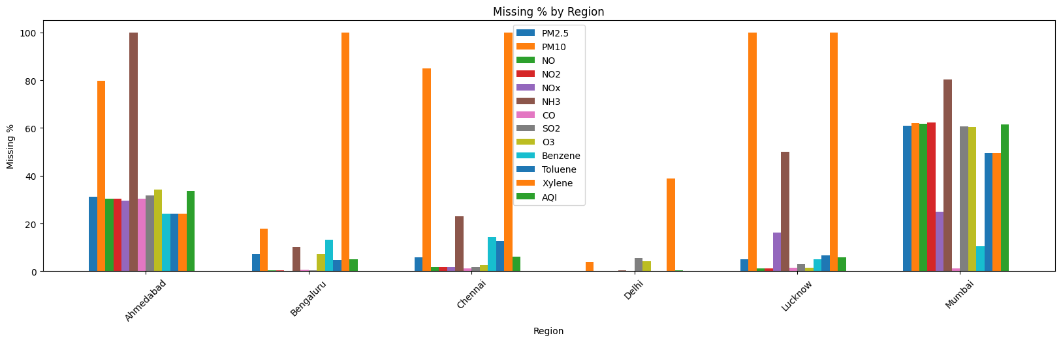
Data Processing
Original dataset has 29531 rows and contains data from 26 regions
Only 6 regions has full-length data from 2015-01-01 ~ 2020-07-01
Ahmedabad and Mumbai has too many missing data across all columns = dropped
Interpolation was made using na_ma from imputeTS package
Moving Average = na_ma(data, k = 15, weighting = "exponential")
Notes:
Welly
Present: Welly

Slide 7
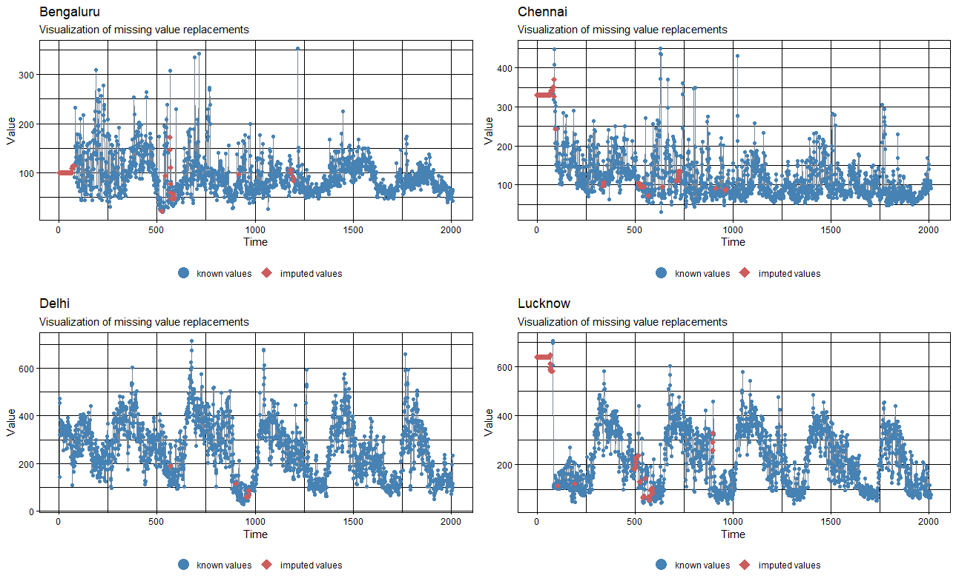
Data Imputations
After interpolation, 4 regions$AQI each contains 2009 data points.
Notes:
Welly
Present: Welly
Kshitiz: Added some EDA plots. These EDA should come after talking about data, missing values, and preprocessing.
Insights:
AQI is constant throughout the year for Bengaluru and Chennai (South India). In North India, AQI increases significantly in winter months. There are several reasons for this: agricultural waste burning is one major reason, increased heating through biomass burning (wood, coal) in North India because North India tends to be much cooler during the winters than South India, fog formation which traps air pollutants, low wind speeds traps air pollutants, and temperature inversion which lets accumulation of pollutants near ground.
Another controversial reason: Diwali festival during November in which firecrackers are burned which in turn leads to air pollution but this reason may offend certain people because of religious reasons so it’s best to avoid it

Slide 8
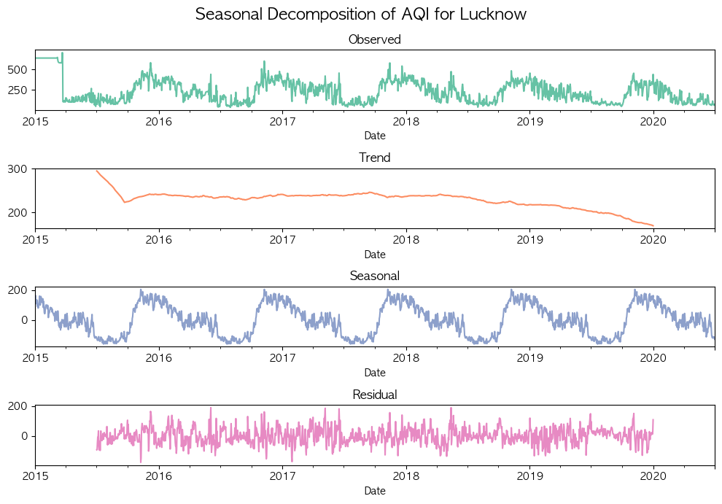
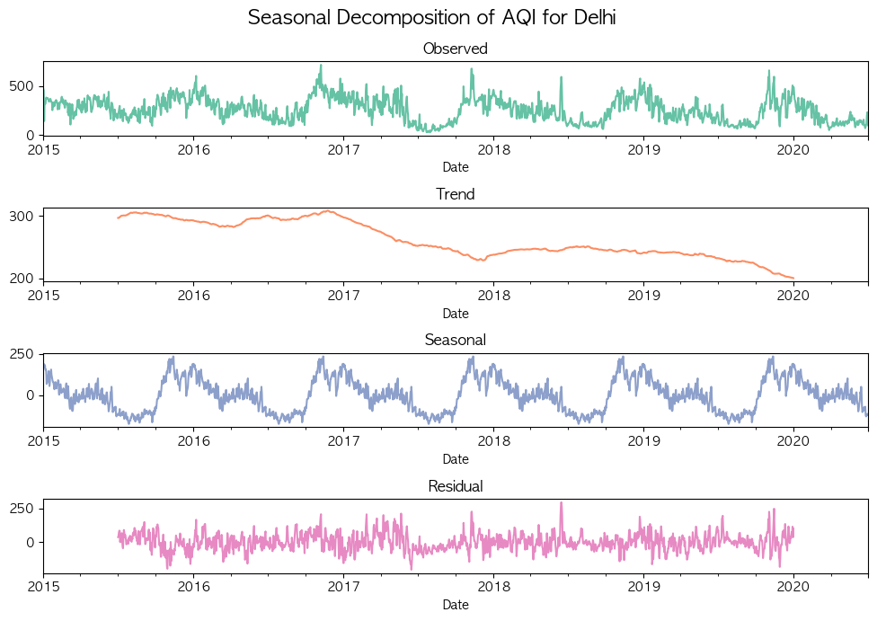
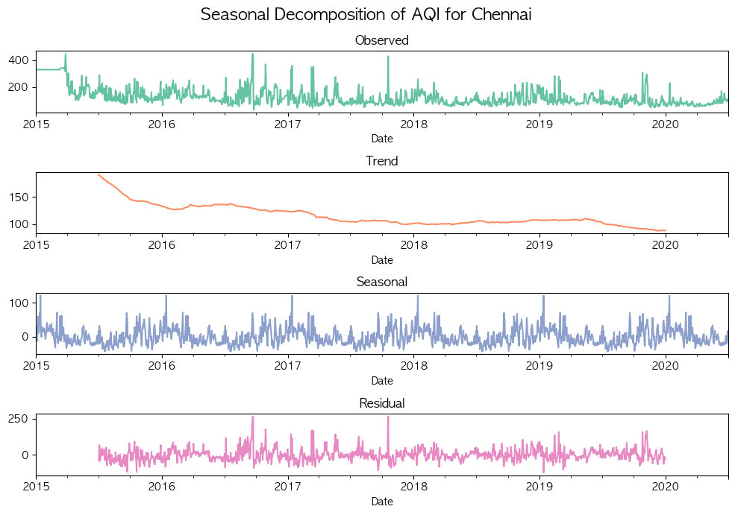
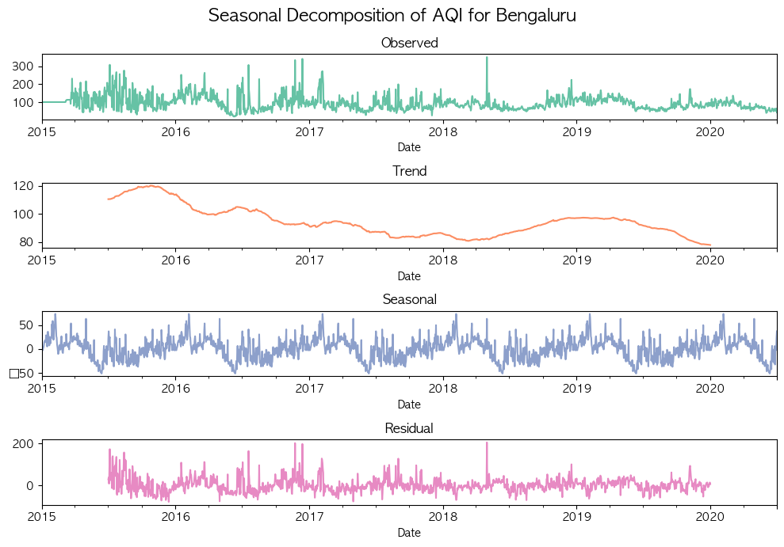
Data Properties/EDA
Lucknow
Delhi
Commonalities
Seasonal Presence: All cities exhibit some level of seasonality in AQI, indicating a cyclic pattern that repeats annually
Differences
Chennai
Bengaluru
Lucknow: Strong seasonal fluctuations, peak in late winter.
Delhi: Moderate seasonality, noticeable peaks in winter months.
Chennai: Weak seasonality, relatively stable throughout the year
Bengaluru: Very mild seasonal changes, minimal fluctuation.
Notes:
Kitae

Slide 9
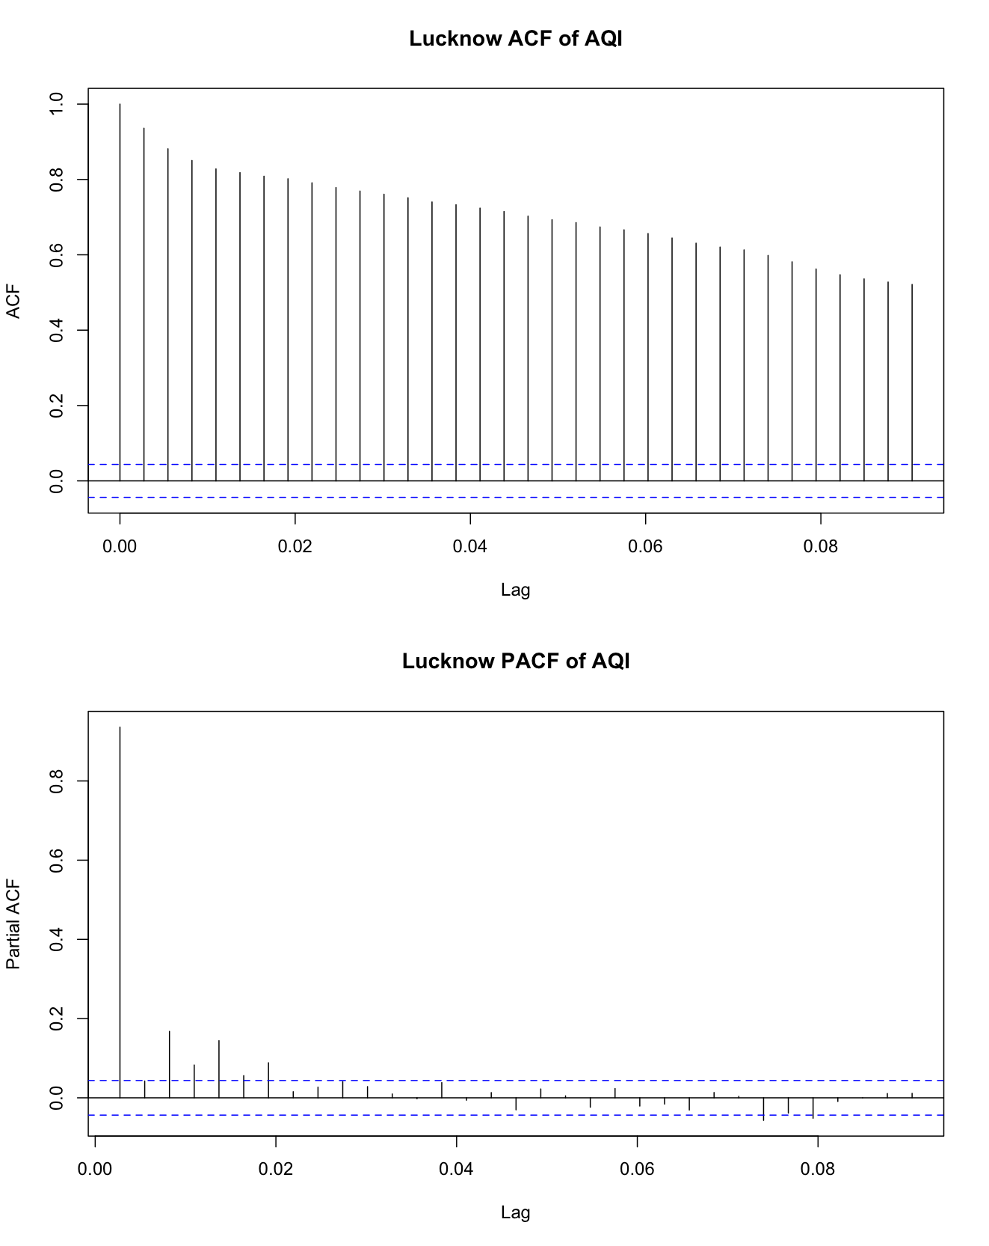
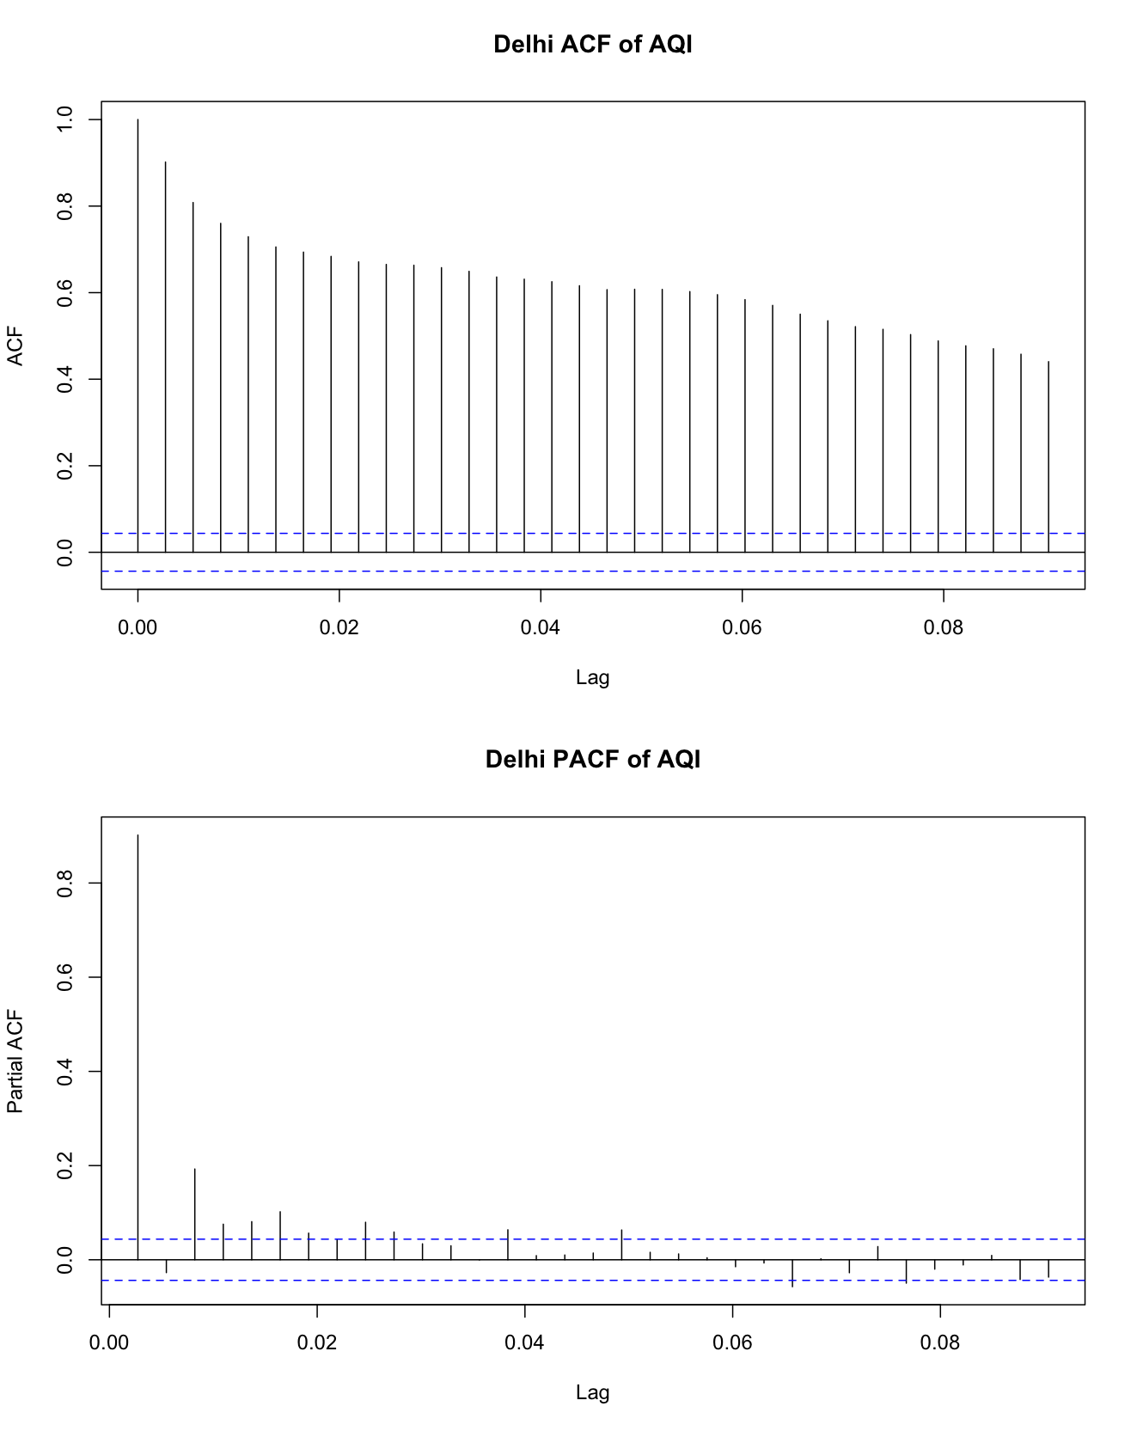
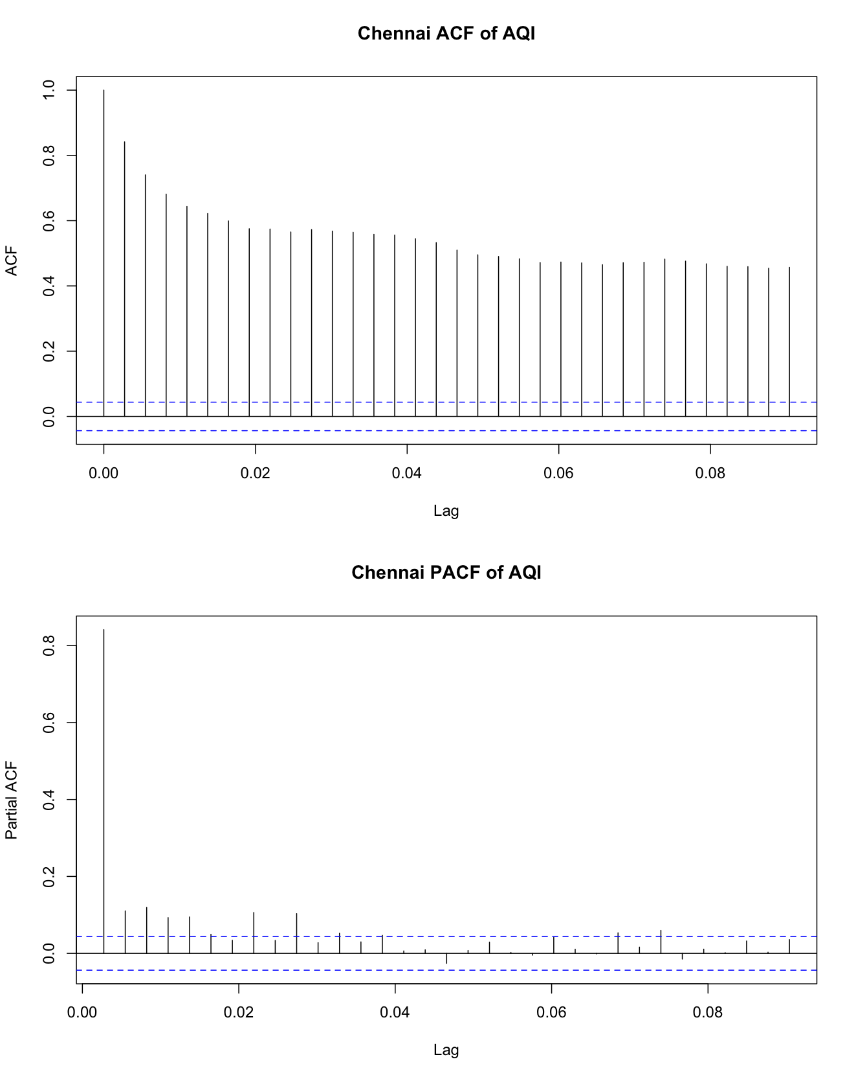
Data Properties/EDA
Lucknow
Delhi
Chennai
Bengaluru
Data stationarity check using ACF and PACF analysis
Data from four regions show instability; adjustments are needed
Using Auto ARIMA to find optimal parameters for P D Q
This method enhances the robustness of our time series forecasting

Slide 10
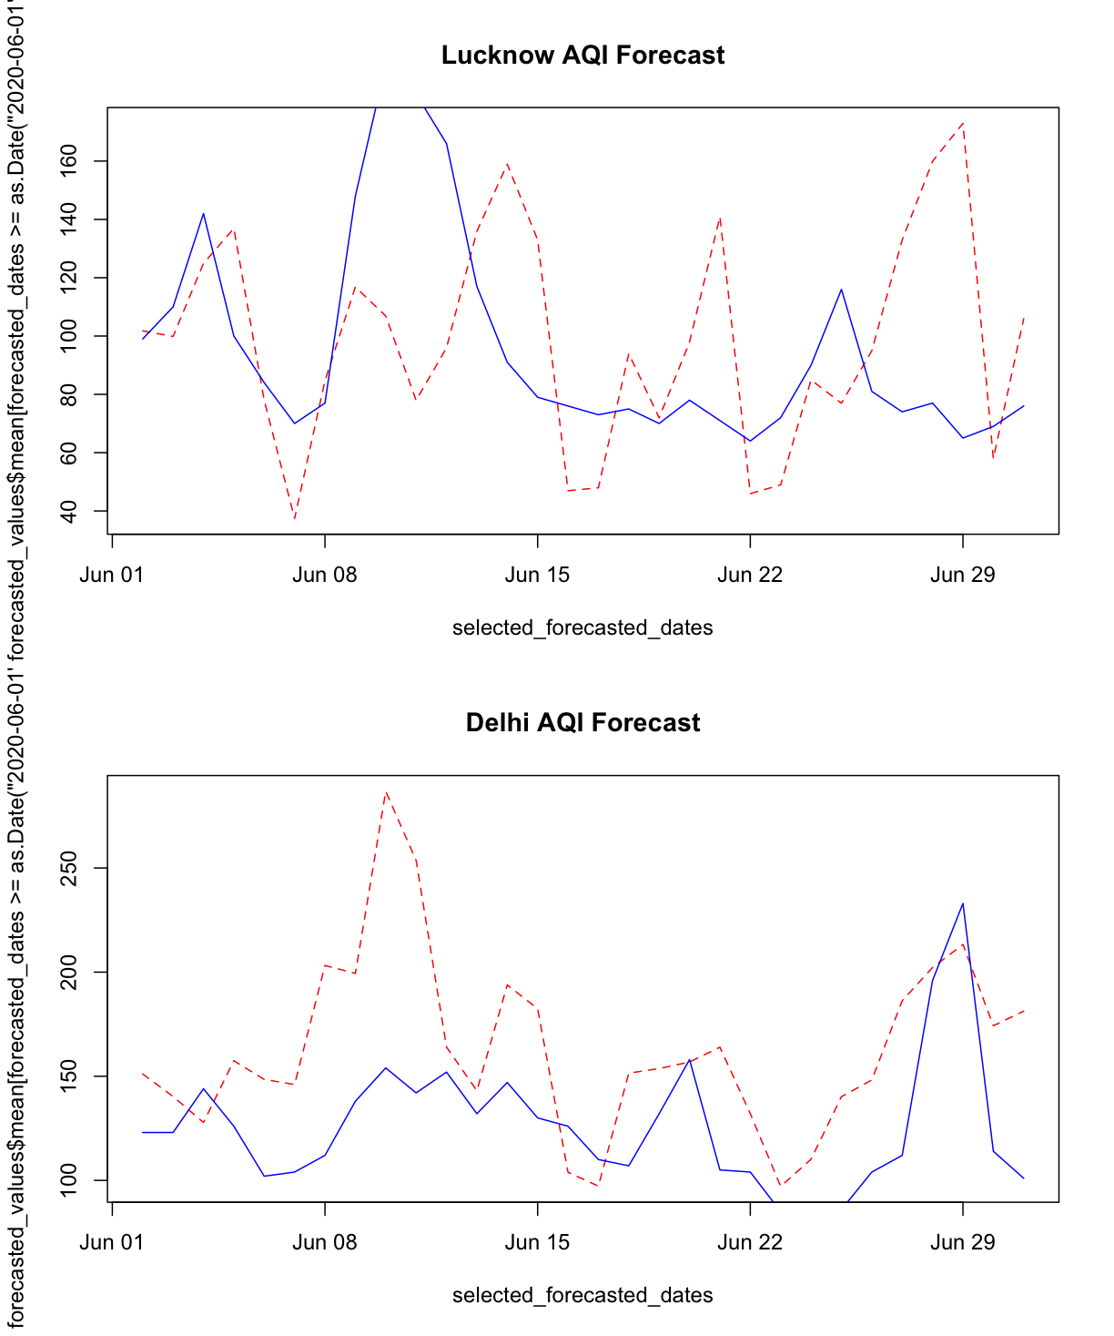
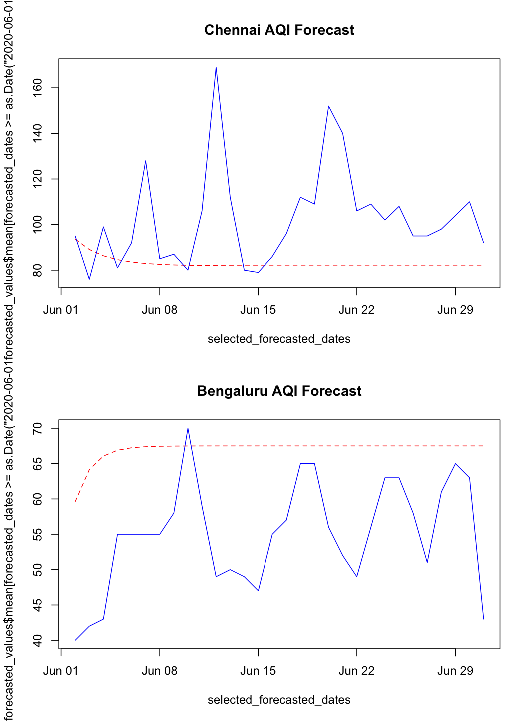
ARIMA
Prediction Result
Metrics for Modeling
City | RMSE | MAE | MAPE | AMAPE
Lucknow | 47.57 | 36.71 | 39.98 | 38.16
Chennai | 29.47 | 21.42 | 18.34 | 20.85
Delhi | 52.78 | 42.68 | 36.48 | 33.93
Bengaluru | 13.88 | 12.24 | 24.40 | 22.27
Bengaluru shows the highest forecast accuracy with the lowest RMSE and MAE values.
Delhi displays the highest error rates, indicating the least accurate predictions.
Chennai has notably low MAPE and AMAPE, suggesting consistent and reliable forecasts.
Lucknow experiences moderate forecasting errors, positioned between the best and worst performing cities.
Notes:
Kitae

Slide 11
ARMA-GARCH: Overview
About ARMA-GARCH
ARMA model for the linear dependencies + GARCH model for the conditional heteroskedasticity
Suitable for modeling and forecasting time series data with changing volatility over time.
Why ARMA-GARCH for AQI forecasting?
Heteroskedasticity: ACF plots of squared original data show heteroskedasticity.
Starting Orders: arma(1,1) + garch(1,1)
City | RMSE | MAE | MAPE | AMAPE
Lucknow | 57.9988 | 52.2579 | 62.74 | 62.7362
Chennai | 21.2329 | 14.8511 | 13.66 | 13.6629
Delhi | 80.1953 | 65.9042 | 62.35 | 62.3521
Bengaluru | 33.0371 | 31.7739 | 5944 | 59.4431
Notes:
Welly

Slide 12
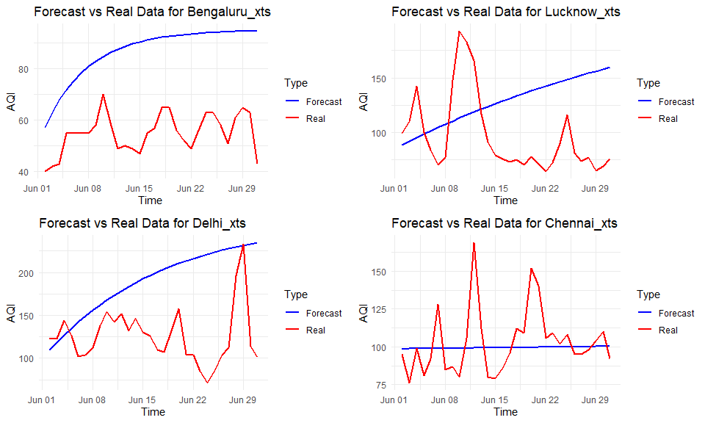
ARMA-GARCH: Initial Model
Notes:
Welly

Slide 13
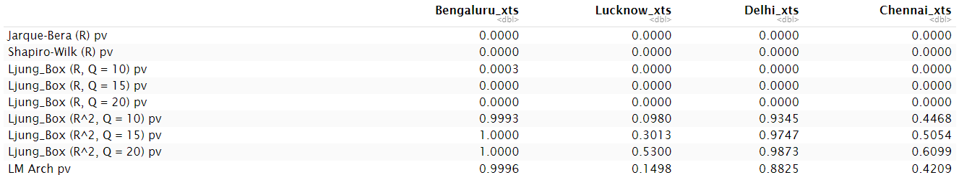
ARMA-GARCH: Improvement
Test on the standardized residuals
Normality Tests (Jarque-Bera and Shapiro-Wilk): Not normally distributed for any of the datasets
Autocorrelation Tests (Ljung-Box for residuals): Significant autocorrelation, indicating that the model has not fully captured the time-series dynamics
Autocorrelation Tests for Squared Residuals (Ljung-Box for R^2):
No significant autocorrelation, suggesting that the GARCH model is effectively capturing the volatility
LM Arch Test:
The GARCH model adequately captures the autoregressive conditional heteroskedasticity in the data.
Notes:
Welly

Slide 14
ARMA-GARCH: Improvement
Used grid search to find the optimal ARMA components
Bengaluru: (1, 1, 1)
Lucknow: (0, 1, 4)
Delhi: (1, 1, 2)
Chennai: (1, 1, 1)
Differentiate the time series by d = 1 and run ~ arma(p, q) + garch(1, 1)
City | RMSE | MAE | MAPE | AMAPE
Lucknow | 101.8298 | 95.6396 | 99.53 | 99.5317
Chennai | 105.5568 | 103.4924 | 100.8 | 100.7989
Delhi | 129.1922 | 125.1313 | 99.50 | 99.4955
Bengaluru | 55.0340 | 54.3562 | 98.57 | 98.5669
Notes:
Welly

Slide 15
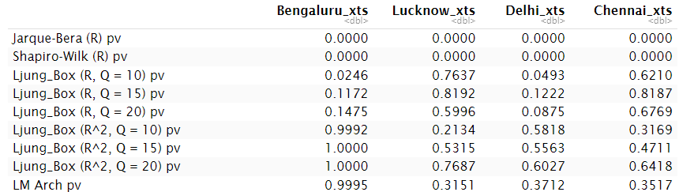
ARMA-GARCH: Improvement
Test on the standardized residuals
Normality Tests (Jarque-Bera and Shapiro-Wilk): Still not normally distributed for any of the datasets
Autocorrelation Tests (Ljung-Box for residuals): Reduced significance for autocorrelation, indicating that the model has captured the time-series dynamics
Autocorrelation Tests for Squared Residuals (Ljung-Box for R^2):
No significant autocorrelation, suggesting that the GARCH model is effectively capturing the volatility
LM Arch Test:
The GARCH model adequately captures the autoregressive conditional heteroskedasticity in the data.
Notes:
Welly

Slide 16
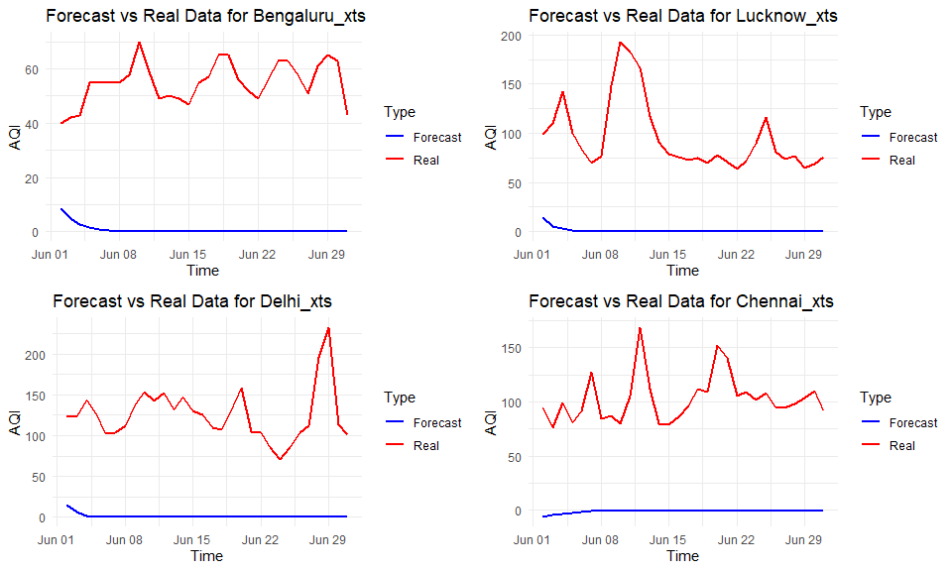
ARMA-GARCH: Improvement
Notes:
Welly

Slide 17
VARIMA: Model Overview & Results
About VARIMA
Multivariate time series Model
Forecasting by past observations of itself and of the other variables within the data set
Why VARIMA for AQI forecasting?
Spatial Interdependencies: Regions in India may exhibit spatial interdependencies in terms of air quality.
Integration and Differencing: Air quality data may be non-stationary, exhibiting trends and seasonality.
City | RMSE | MAE | MAPE | AMAPE
Lucknow | 35.37972 | 30.05236 | 32.55386 | 29.52032
Chennai | 24.33768 | 17.26720 | 15.04081 | 16.54072
Delhi | 32.77869 | 23.93517 | 19.07055 | 18.68528
Bengaluru | 35.37972 | 30.05236 | 32.55386 | 29.52032
Notes:
Katy
VARIMA model can be particularly useful due to the complex geographical and environmental interactions that affect air quality across different regions. For instance, industrial activity in one area might affect air quality in neighboring areas due to the movement of air masses. VARIMA can model such interdependencies between multiple time series (e.g., air quality measurements from multiple monitoring stations).

Slide 18
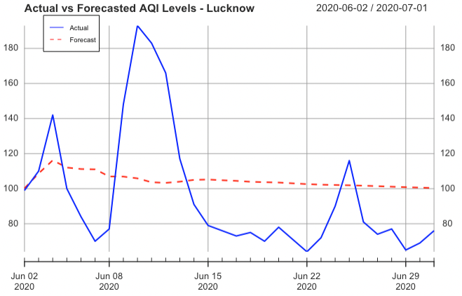
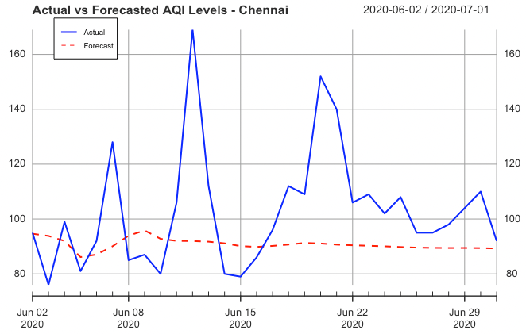
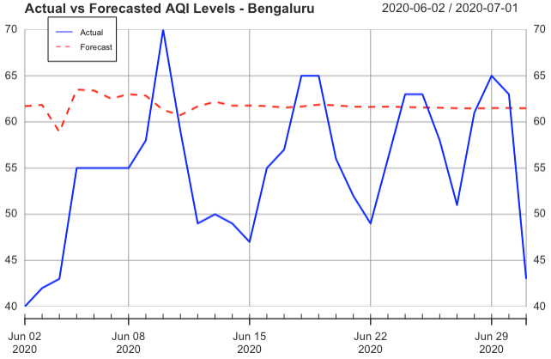
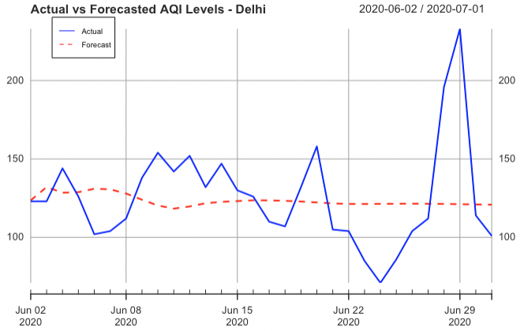
VARIMA: Actual vs Forecast
Lucknow
Chennai
Bengaluru
Delhi
Notes:
Kshitiz

Slide 19
Prophet: Model Overview & Results
About Prophet
Developed by Facebook
Automatic detect trends and seasonality with minimal manual training
Intuitive and user-friendly
Why Prophet for AQI forecasting?
Prophet excels at capturing daily, weekly, monthly, and yearly seasonal effects and can incorporate holidays or special events.
City | RMSE | MAE | MAPE | AMAPE
Lucknow | 43.8092 | 32.99207 | 0.3155502 | 40.46366
Chennai | 55.41889 | 49.7491 | 0.4633163 | 62.37414
Delhi | 48.23874 | 30.73455 | 0.2210615 | 26.18271
Bengaluru | 14.58552 | 11.92744 | 0.2166511 | 22.76304
Notes:
Kshitiz

Slide 20
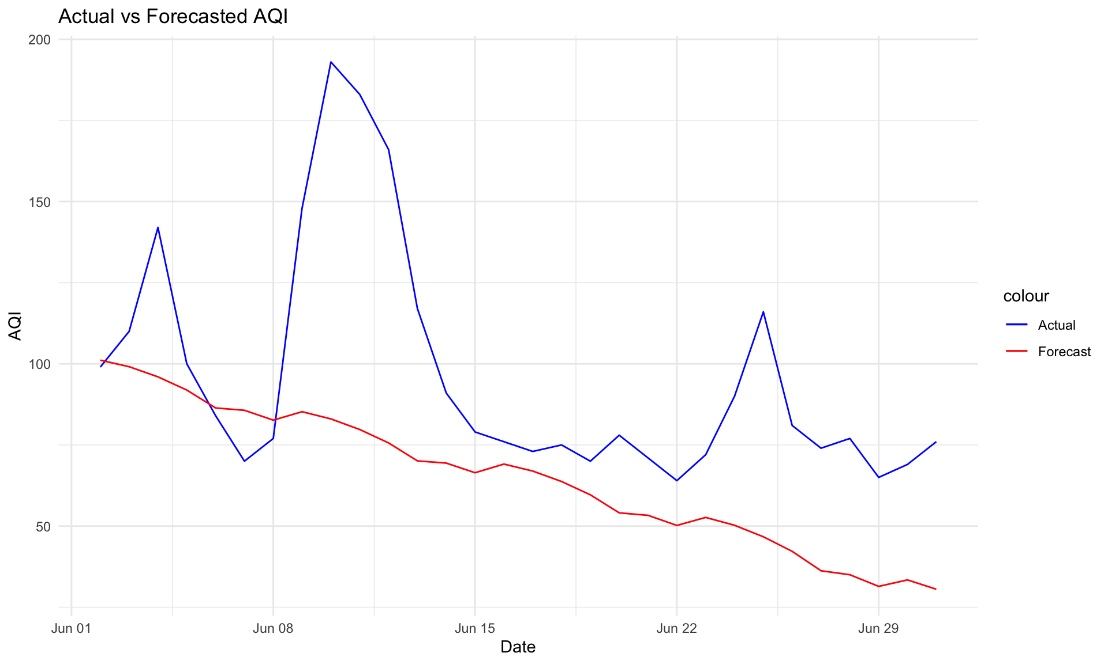
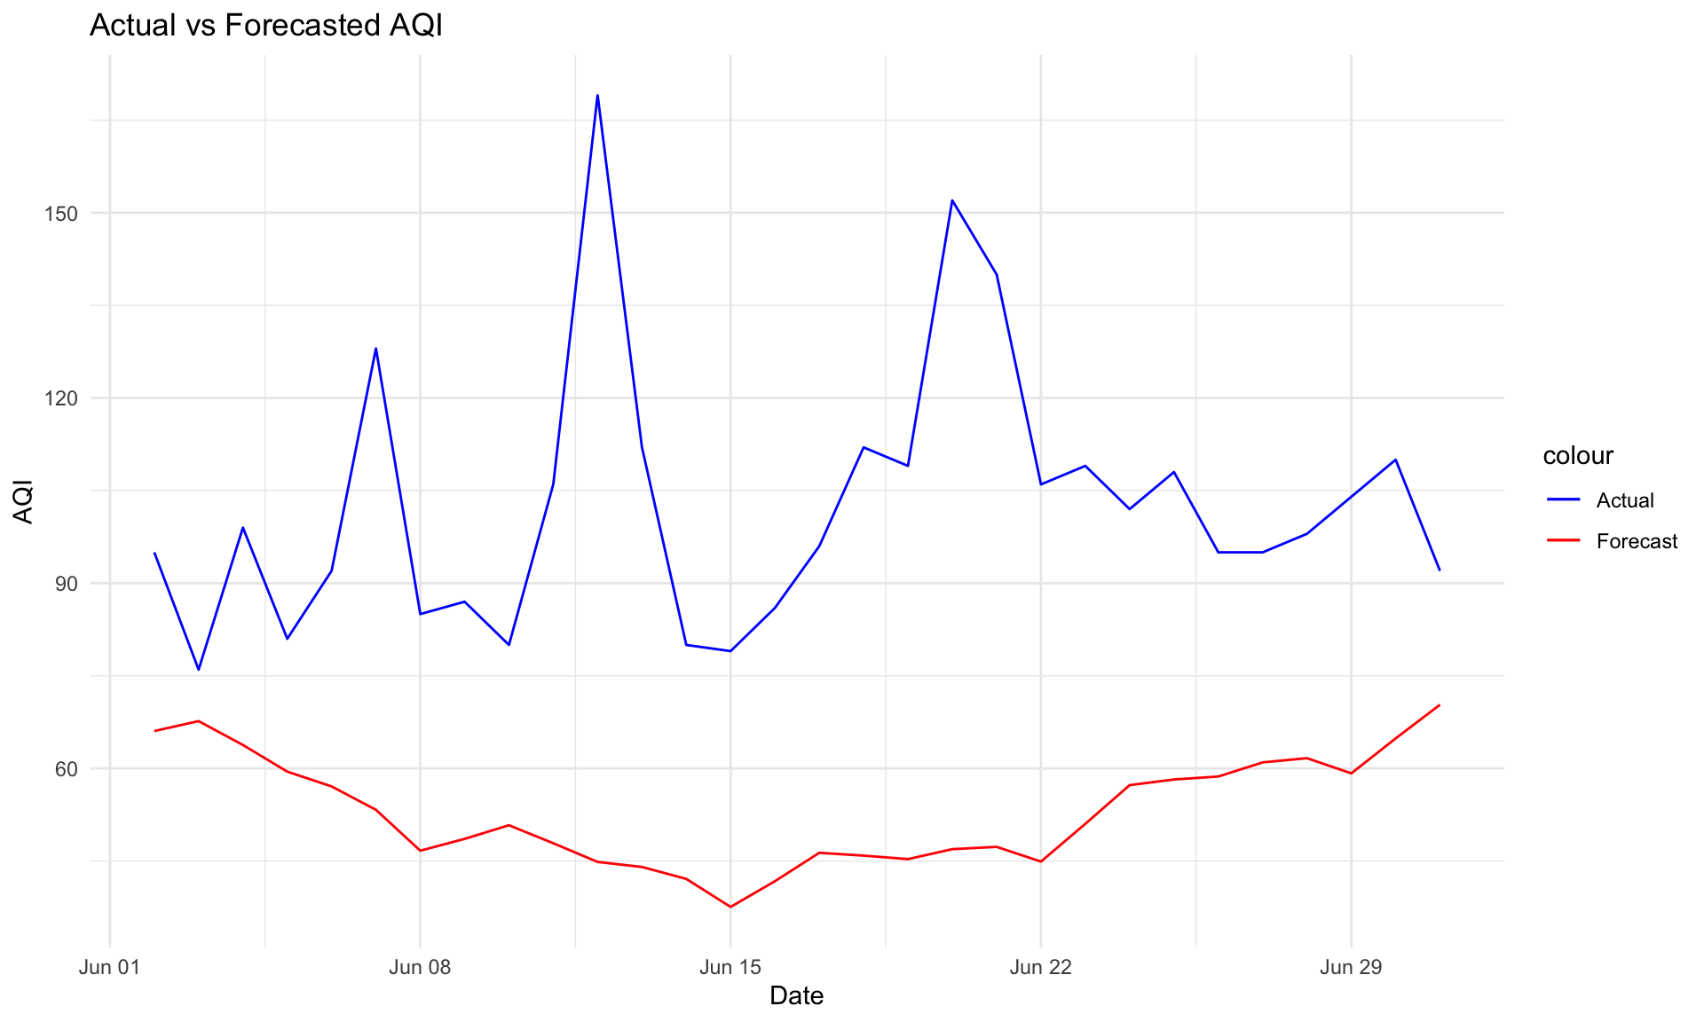
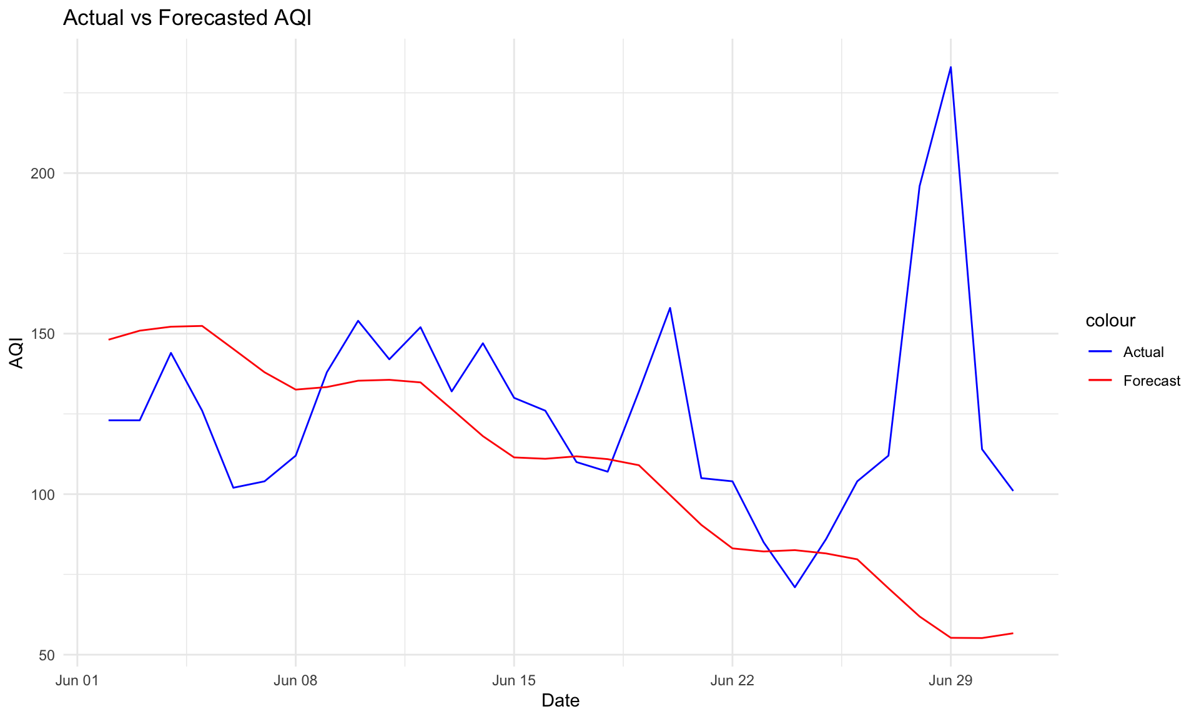
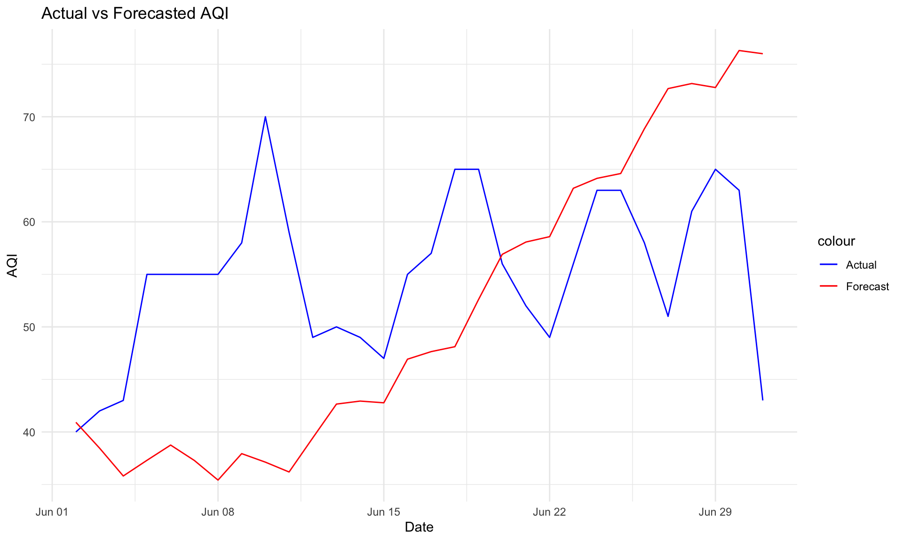
Prophet: Actual vs Forecast
Lucknow
Chennai
Delhi
Bengaluru
Notes:
Kshitiz

Slide 21
Results
Lucknow
Delhi
Model | RMSE | MAE | MAPE % | AMAPE %
ARIMA | 47.57 | 36.71 | 39.98 | 38.16
ARMA GARCH | 58.00 | 52.26 | 63.00 | 62.74
VARIMA | 35.38 | 30.05 | 32.55 | 29.52
Prophet | 43.8 | 32.9 | 31.50 | 40.4
Model | RMSE | MAE | MAPE % | AMAPE %
ARIMA | 52.78 | 42.68 | 36.48 | 33.93
ARMA GARCH | 80.20 | 65.90 | 62.00 | 62.35
VARIMA | 32.78 | 23.94 | 19.07 | 18.69
Prophet | 48.2 | 30.7 | 22.00 | 26.2
Chennai
Bengaluru
Model | RMSE | MAE | MAPE % | AMAPE %
ARIMA | 29.47 | 21.42 | 18.34 | 20.85
ARMA GARCH | 21.23 | 14.85 | 14.00 | 13.66
VARIMA | 24.34 | 17.27 | 15.04 | 16.54
Prophet | 55.4 | 49.7 | 46.3 | 62.4
Model | RMSE | MAE | MAPE % | AMAPE %
ARIMA | 52.78 | 12.24 | 24.40 | 22.27
ARMA GARCH | 33.03 | 31.77 | 59.00 | 59.44
VARIMA | 35.38 | 30.05 | 32.55 | 29.52
Prophet | 14.5 | 11.9 | 21.00 | 22.7
Notes:
Kshitiz

Slide 22
Future Work
Incorporate additional exogenous variables like weather data, traffic data, industrial emissions, and social events
Explore more advanced models like LSTM, GRU, and hybrid models
Account for spatial dependencies between different regions using techniques
Incorporate holiday effects, COVID impact, and other seasonal events
Real-time forecasting
Notes:
Kshitiz

Slide 23
Appendix

Slide 24
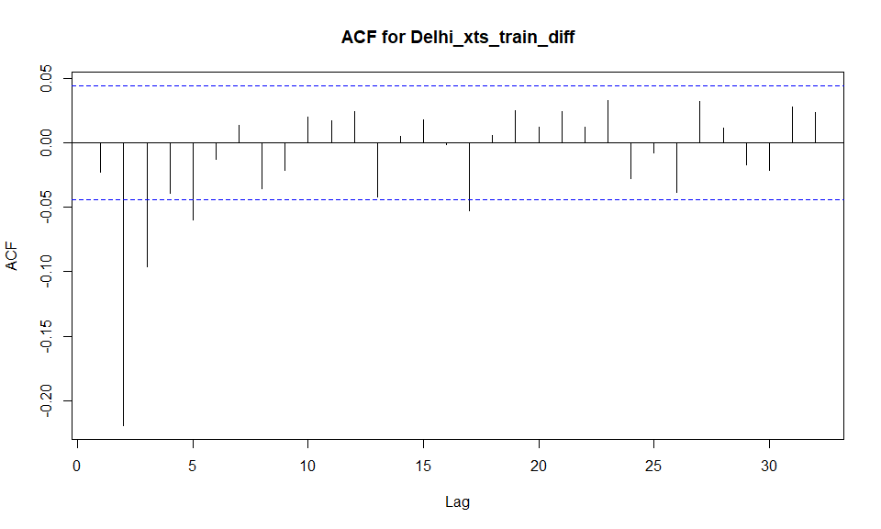
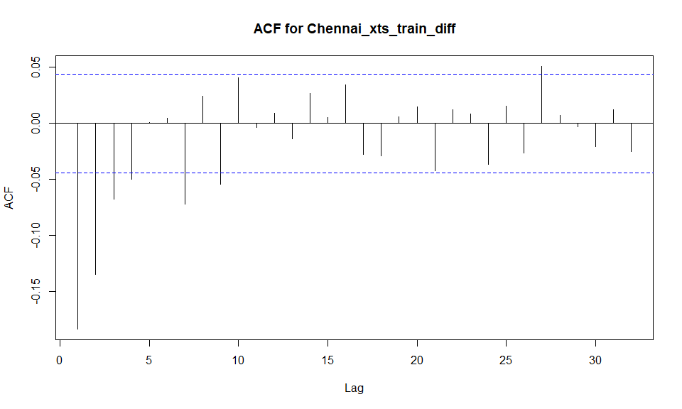
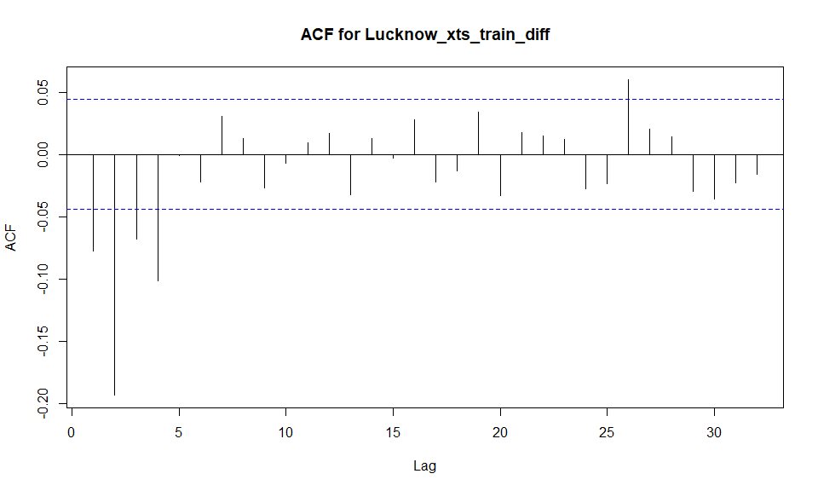
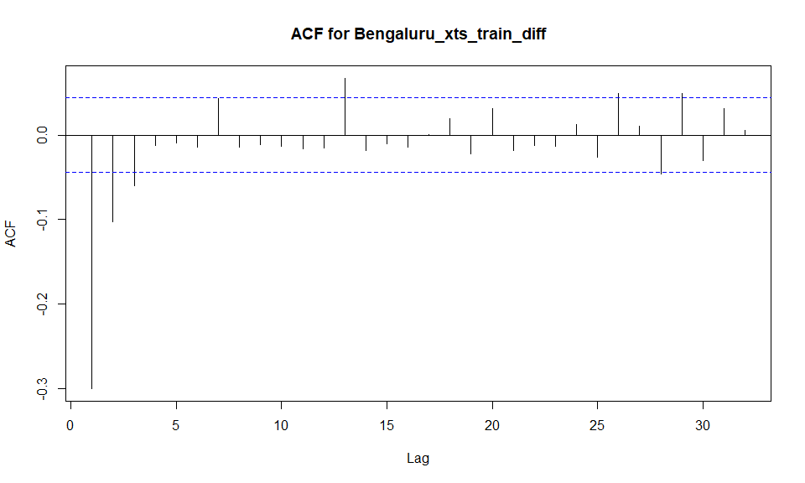
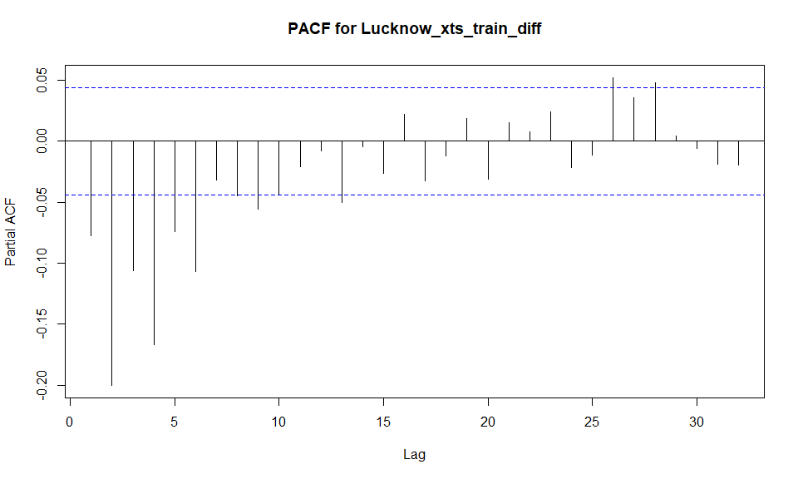
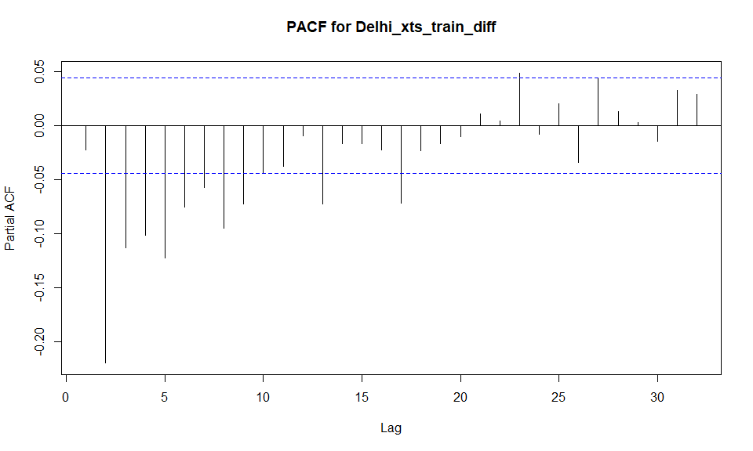
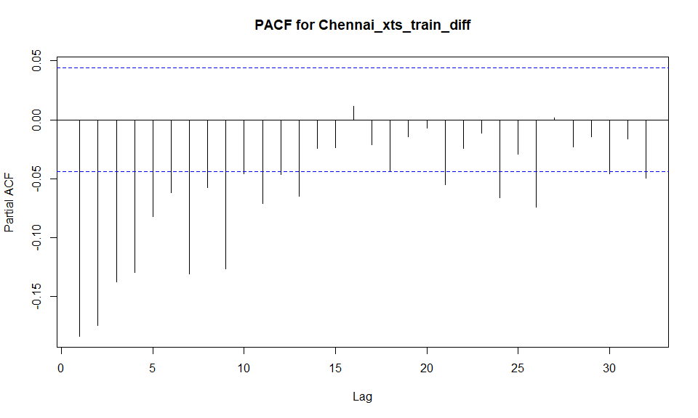
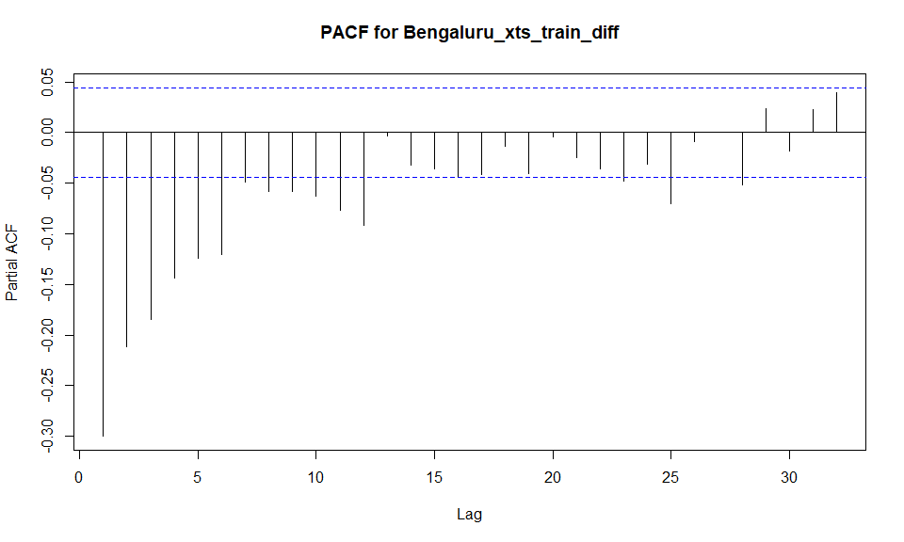
ACF & PACF for Differentiated Data (d = 1)
Lucknow
Delhi
Chennai
Bengaluru
Differencing removes trends and cycles, stabilizing mean across the series.
Reduces dependence among values, enhancing model's predictive accuracy and stability.

Slide 25
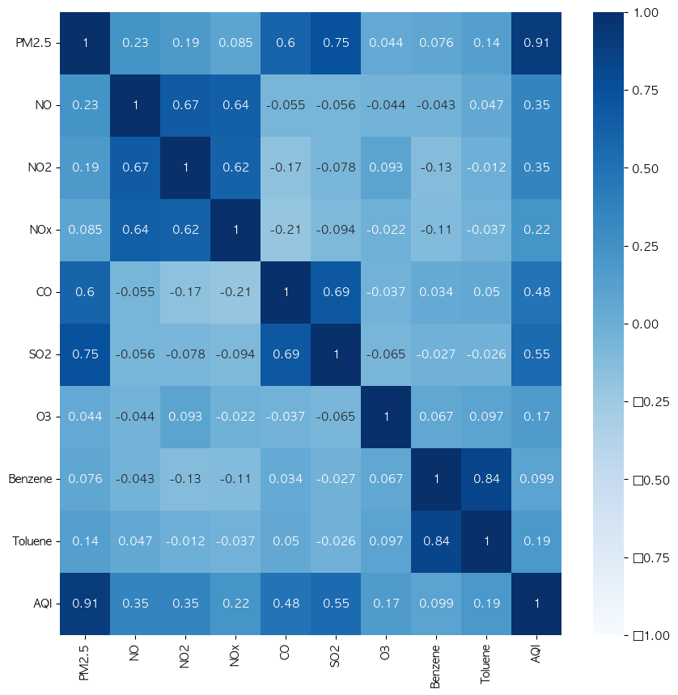

Appendix
All features are needed to do analysis?
The concentration of each pollutant is converted into a sub-index
and the highest sub-index value among the pollutants is taken as the final AQI
India's Air Quality Index (AQI) considers the highest sub-index among various pollutants as the final AQI
This means that the AQI is determined based on the pollutant with the highest sub-index value, reflecting the most severe impact on air quality
Notes:
Kshitiz

